Slide 1
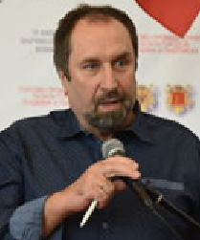
ФОРУМ БРИКС+ 22 сентября 2020
Сочи, Россия
я 2020
Сочи, Россия
докладчик:
Вакуленко Валерий Михайлович, к.э.н, CCIM. ГЛАВА ЦЕНТРА СОДЕЙСТВИЯ ПРОДВИЖЕНИЮ ЦУР ООН И СОХРАНЕНИЮ ПРИРОДЫ И HOMO SAPIENS, “ECOSANACLUB”
«Уникальный потенциал стран БРИКС+ в сфере Глобального ЭКО-Устойчивого Развития и его эффективная реализация».
www.ecosana.club
WhatsApp, tel +79111777716; vakulenko@ecoestate.tv
Assistance Center for saving Nature & Homo Sapiens

Slide 2
FORUM BRICS+ 22nd of September 2020
Sochi, Russia
я 2020
Сочи, Россия
SPEAKER:
Valery Vakulenko,
Ph.D.inECO, CCIM. HEAD OF THE CENTER FOR PROMOTING THE UN SDGs AND SAIVING NATURE & HOMO SAPIENS,
“ECOSANACLUB”
"The unique potential of the BRICS+ countries in the field of Global ECO-Sustainable Development and its effective implementation ”.
www.ecosana.club
WhatsApp, tel +79111777716; vakulenko@ecoestate.tv
Assistance Center for saving Nature & Homo Sapiens

Slide 3
FORUM BRICS+ 22.09.2020 Sochi, Russia
Valery Vakulenko
"The unique potential of the BRICS+ countries in the field of Global ECO-Sustainable Development and its effective implementation ”.
БРИКС+ – это структура, которая может обеспечить новых лидеров для новой экономики, создав и развив на своей базе клуб экодержав.
www.ecosana.club vakulenko@ecoestate.tv;
WhatsApp, tel +79111777716
Assistance Center for saving Nature & Homo Sapiens

Slide 4
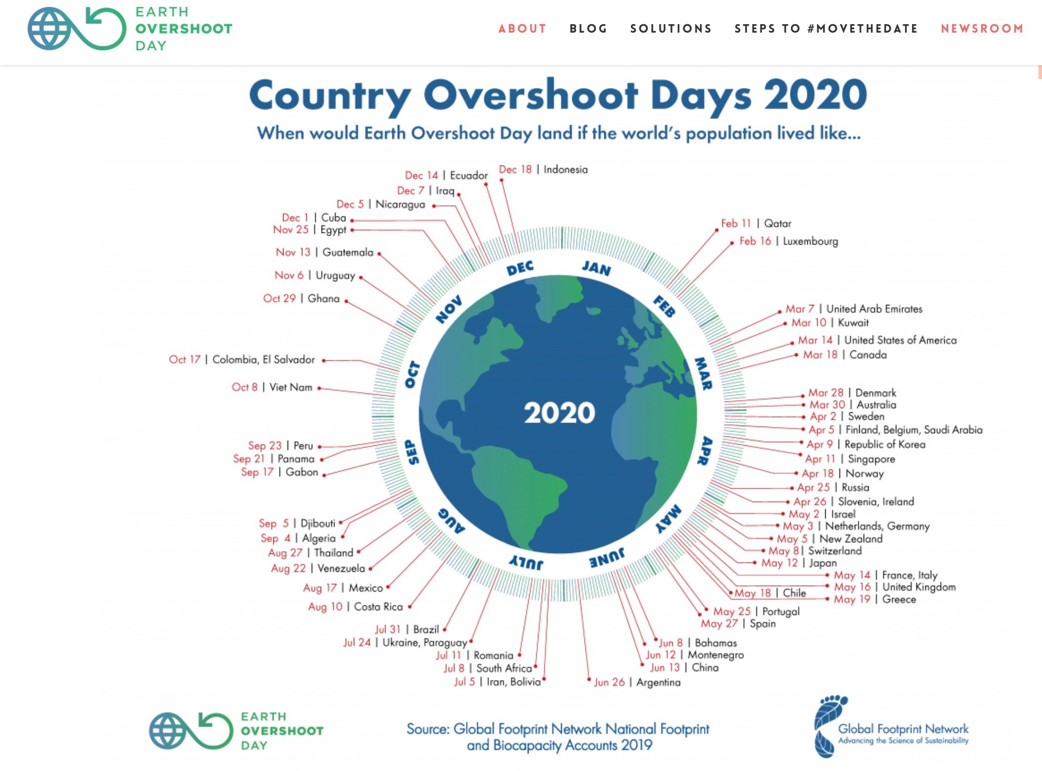
FORUM BRICS+ 22.09.2020 Sochi, Russia
Valery Vakulenko
"The unique potential of the BRICS+ countries in the field of Global ECO-Sustainable Development and its effective implementation ”.
Мотиватор – выживание
Витальные экологические проблемы
www.ecosana.club vakulenko@ecoestate.tv;
WhatsApp, tel +79111777716
Assistance Center for saving Nature & Homo Sapiens

Slide 5
FORUM BRICS+ 22.09.2020 Sochi, Russia
Valery Vakulenko
"The unique potential of the BRICS+ countries in the field of Global ECO-Sustainable Development and its effective implementation ”.
Мотиватор – выживание
Необратимые потери в биосфере
www.ecosana.club vakulenko@ecoestate.tv;
WhatsApp, tel +79111777716
Assistance Center for saving Nature & Homo Sapiens

Slide 6
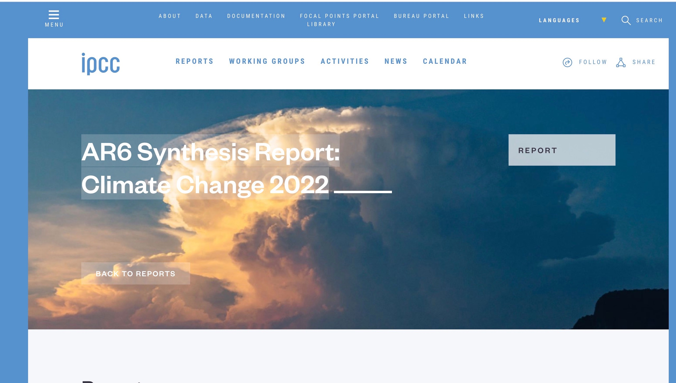
FORUM BRICS+ 22.09.2020 Sochi, Russia
Valery Vakulenko
"The unique potential of the BRICS+ countries in the field of Global ECO-Sustainable Development and its effective implementation ”.
Мотиватор – выживание
Глобальное изменение климата
www.ecosana.club vakulenko@ecoestate.tv;
WhatsApp, tel +79111777716
Assistance Center for saving Nature & Homo Sapiens

Slide 7
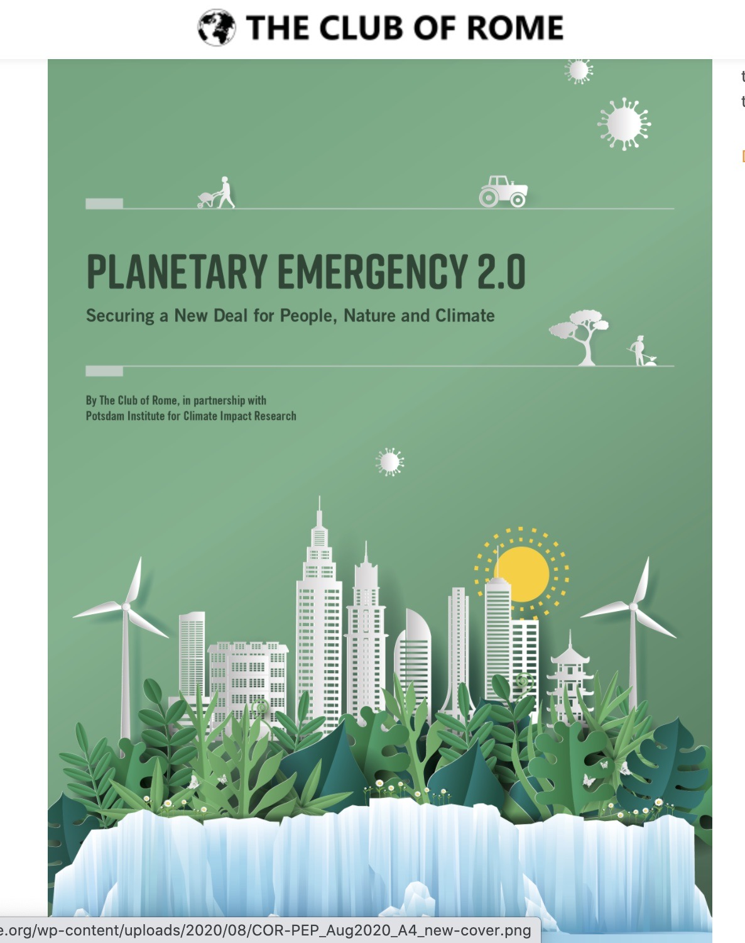
FORUM BRICS+ 22.09.2020 Sochi, Russia
Valery Vakulenko
"The unique potential of the BRICS+ countries in the field of Global ECO-Sustainable Development and its effective implementation ”.
Мотиватор – выживание
Доклад Римского клуба
www.ecosana.club vakulenko@ecoestate.tv;
WhatsApp, tel +79111777716
Assistance Center for saving Nature & Homo Sapiens

Slide 8
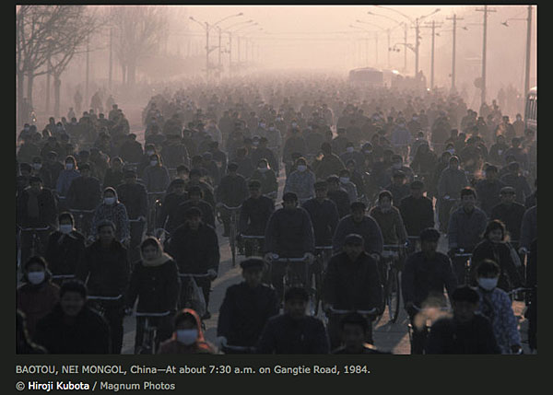
FORUM BRICS+ 22.09.2020 Sochi, Russia
Valery Vakulenko
"The unique potential of the BRICS+ countries in the field of Global ECO-Sustainable Development and its effective implementation ”.
Опыт Китая показывает, что рост ВВП – это не решение проблемы, а, наоборот.
www.ecosana.club vakulenko@ecoestate.tv;
WhatsApp, tel +79111777716
Assistance Center for saving Nature & Homo Sapiens

Slide 9
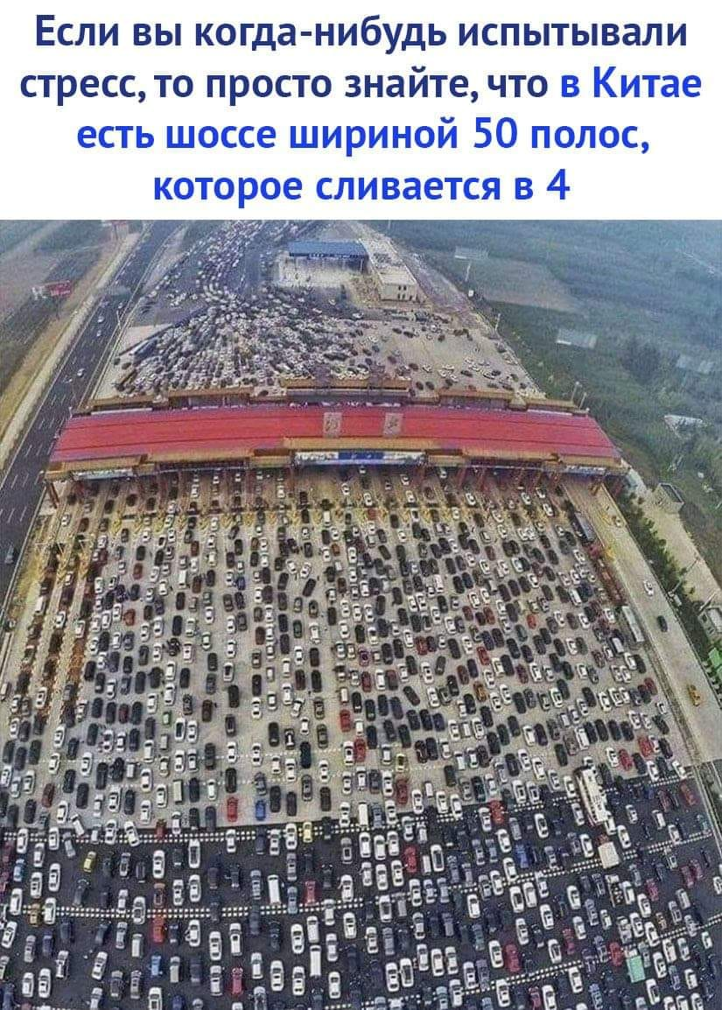
FORUM BRICS+ 22.09.2020 Sochi, Russia
Valery Vakulenko
"The unique potential of the BRICS+ countries in the field of Global ECO-Sustainable Development and its effective implementation ”.
Опыт Китая показывает, что рост ВВП – это не решение проблемы, а, наоборот.
www.ecosana.club vakulenko@ecoestate.tv;
WhatsApp, tel +79111777716
Assistance Center for saving Nature & Homo Sapiens

Slide 10
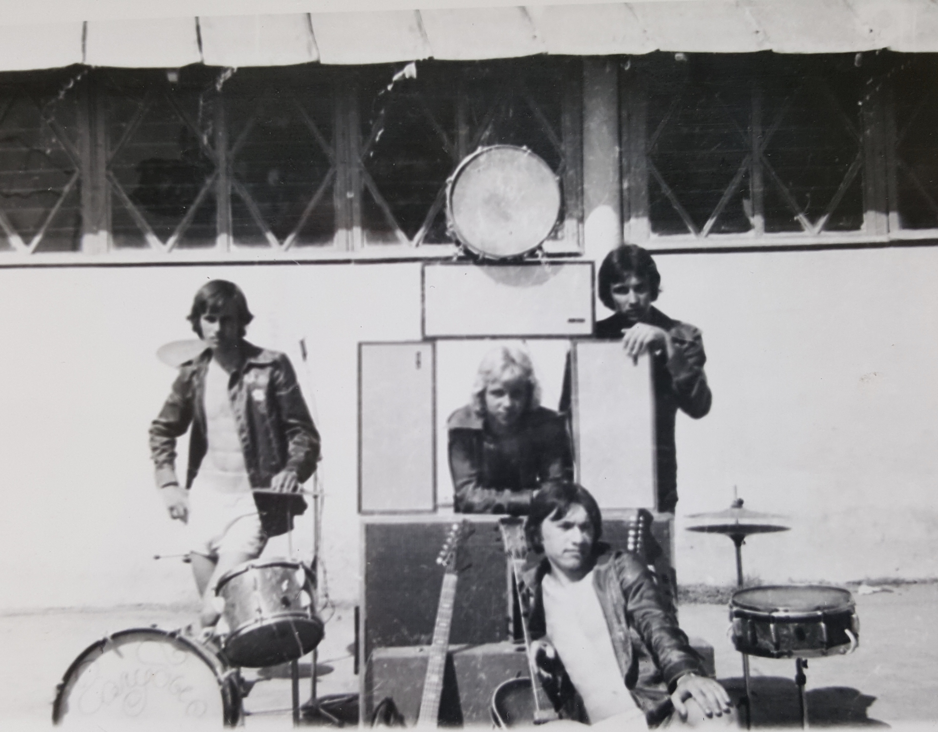
FORUM BRICS+ 22.09.2020 Sochi, Russia
Valery Vakulenko
"The unique potential of the BRICS+ countries in the field of Global ECO-Sustainable Development and its effective implementation ”.
Экологами не рождаются
www.ecosana.club vakulenko@ecoestate.tv;
WhatsApp, tel +79111777716
Assistance Center for saving Nature & Homo Sapiens

Slide 11
FORUM BRICS+ 22.09.2020 Sochi, Russia
Valery Vakulenko
"The unique potential of the BRICS+ countries in the field of Global ECO-Sustainable Development and its effective implementation ”.
Руководство государств и крупных корпораций не хотят брать на себя бремя ответственности за решение глобальных экологических проблем.
ООН – структура, которая показывает готовность эти вопросы решать (приняты Цели Устойчивого Развития), но у нее не хватает эффективных инструментов для этого.
www.ecosana.club vakulenko@ecoestate.tv;
WhatsApp, tel +79111777716
Assistance Center for saving Nature & Homo Sapiens

Slide 12
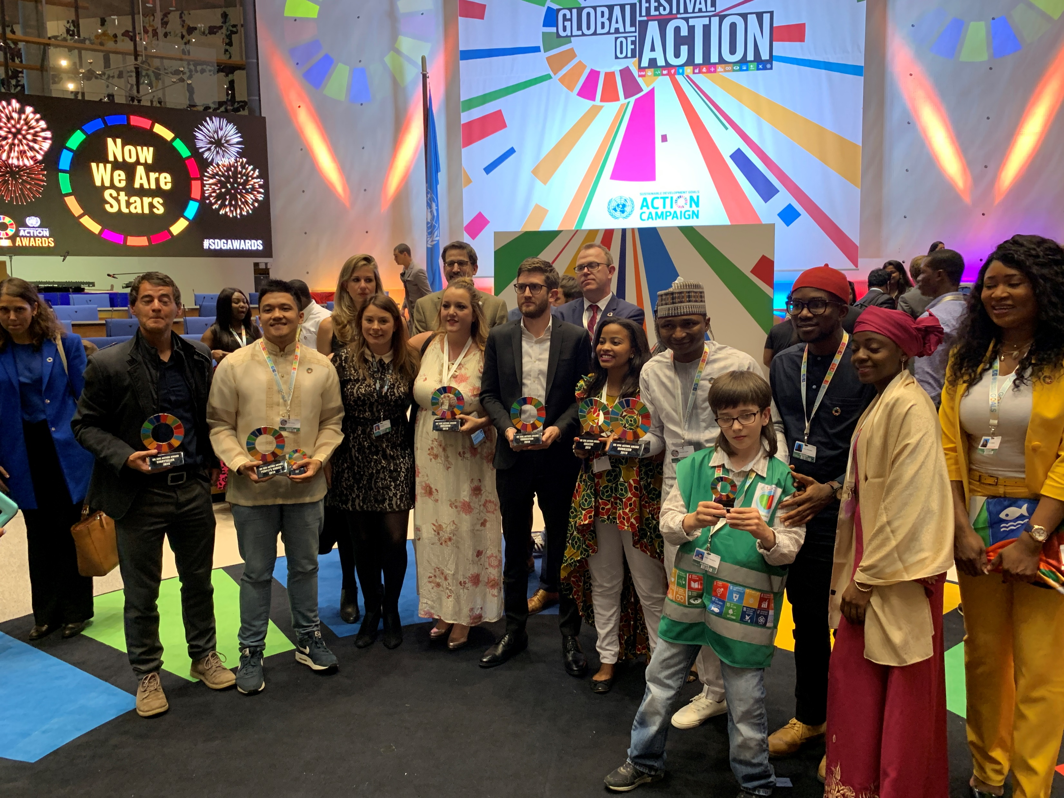
FORUM BRICS+ 22.09.2020 Sochi, Russia
Valery Vakulenko
"The unique potential of the BRICS+ countries in the field of Global ECO-Sustainable Development and its effective implementation ”.
1
www.ecosana.club vakulenko@ecoestate.tv;
WhatsApp, tel +79111777716
Assistance Center for saving Nature & Homo Sapiens

Slide 13
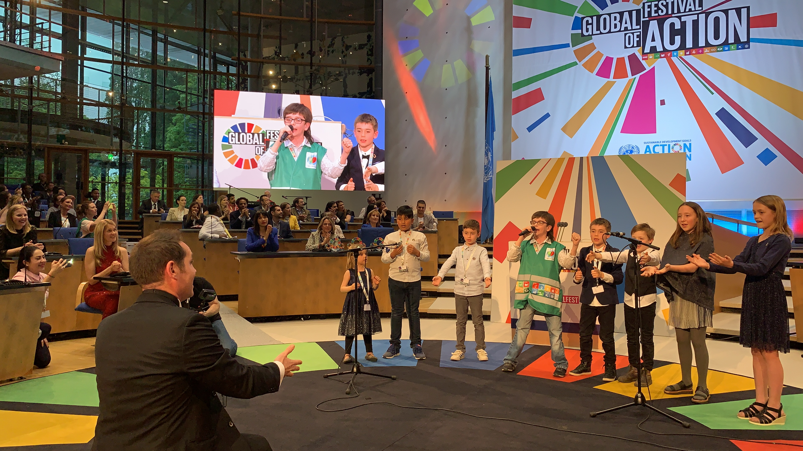
FORUM BRICS+ 22.09.2020 Sochi, Russia
Valery Vakulenko
"The unique potential of the BRICS+ countries in the field of Global ECO-Sustainable Development and its effective implementation ”.
www.ecosana.club vakulenko@ecoestate.tv;
WhatsApp, tel +79111777716
Assistance Center for saving Nature & Homo Sapiens

Slide 14
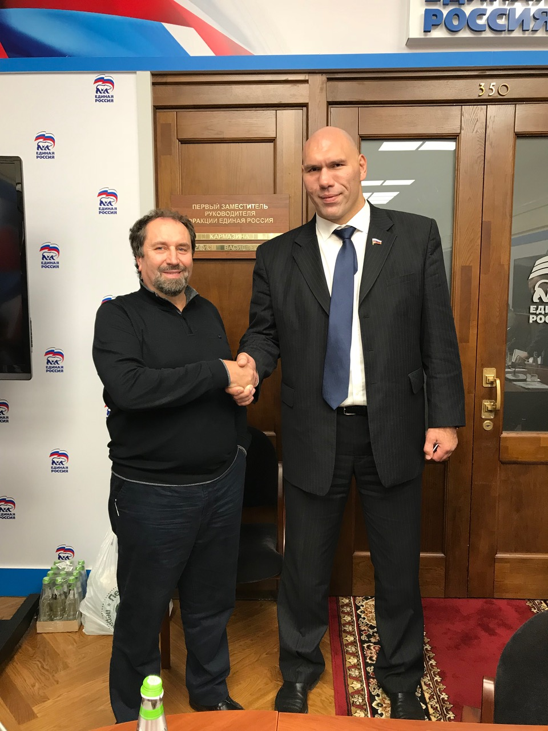
FORUM BRICS+ 22.09.2020 Sochi, Russia
Valery Vakulenko
"The unique potential of the BRICS+ countries in the field of Global ECO-Sustainable Development and its effective implementation ”.
Даже самый большой эколог России из Госдумы, не может противостоять проникновению МСЖ
www.ecosana.club vakulenko@ecoestate.tv;
WhatsApp, tel +79111777716
Assistance Center for saving Nature & Homo Sapiens

Slide 15
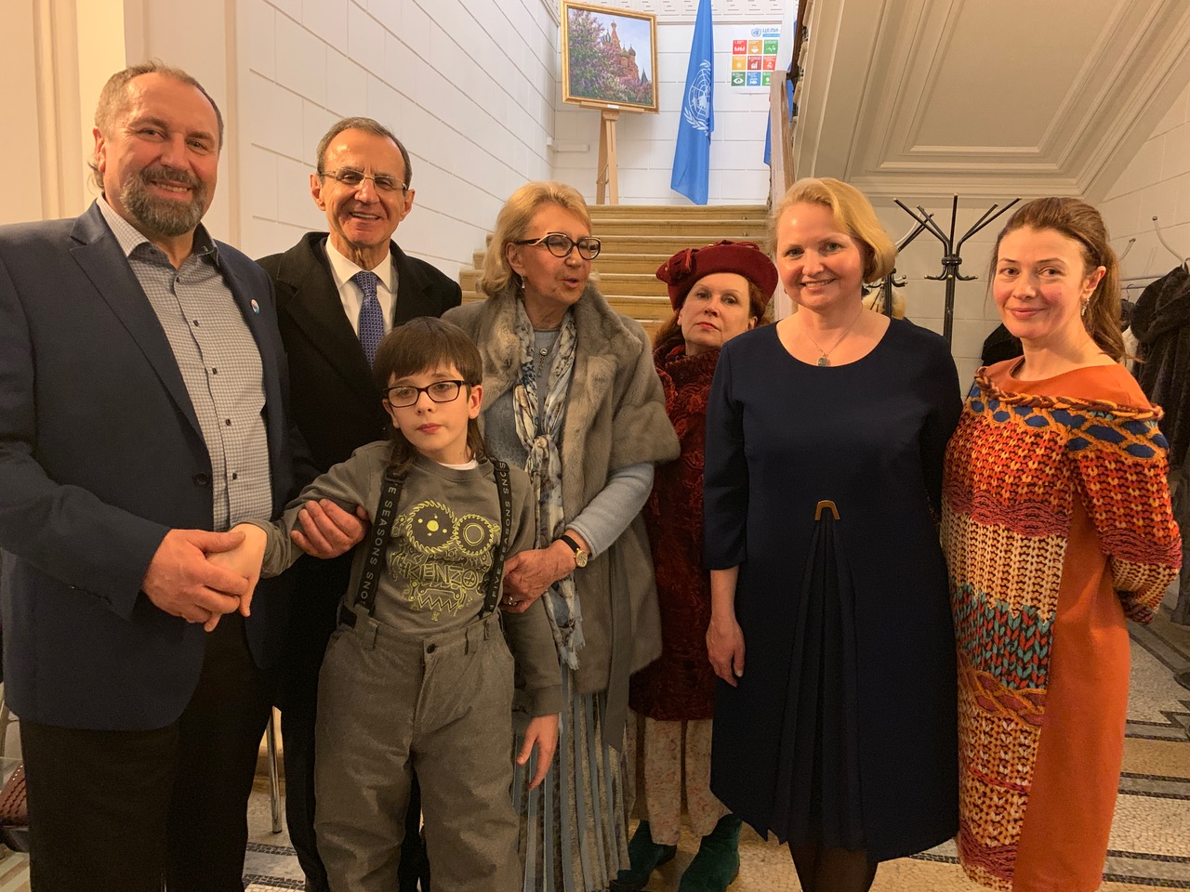
FORUM BRICS+ 22.09.2020 Sochi, Russia
Valery Vakulenko
"The unique potential of the BRICS+ countries in the field of Global ECO-Sustainable Development and its effective implementation ”.
ООН проводит немало мероприятий, но нужно более активно и жестко продвигать идеи ЦУР и более широко взаимодействовать с гражданами всего мира
www.ecosana.club vakulenko@ecoestate.tv;
WhatsApp, tel +79111777716
Assistance Center for saving Nature & Homo Sapiens

Slide 16
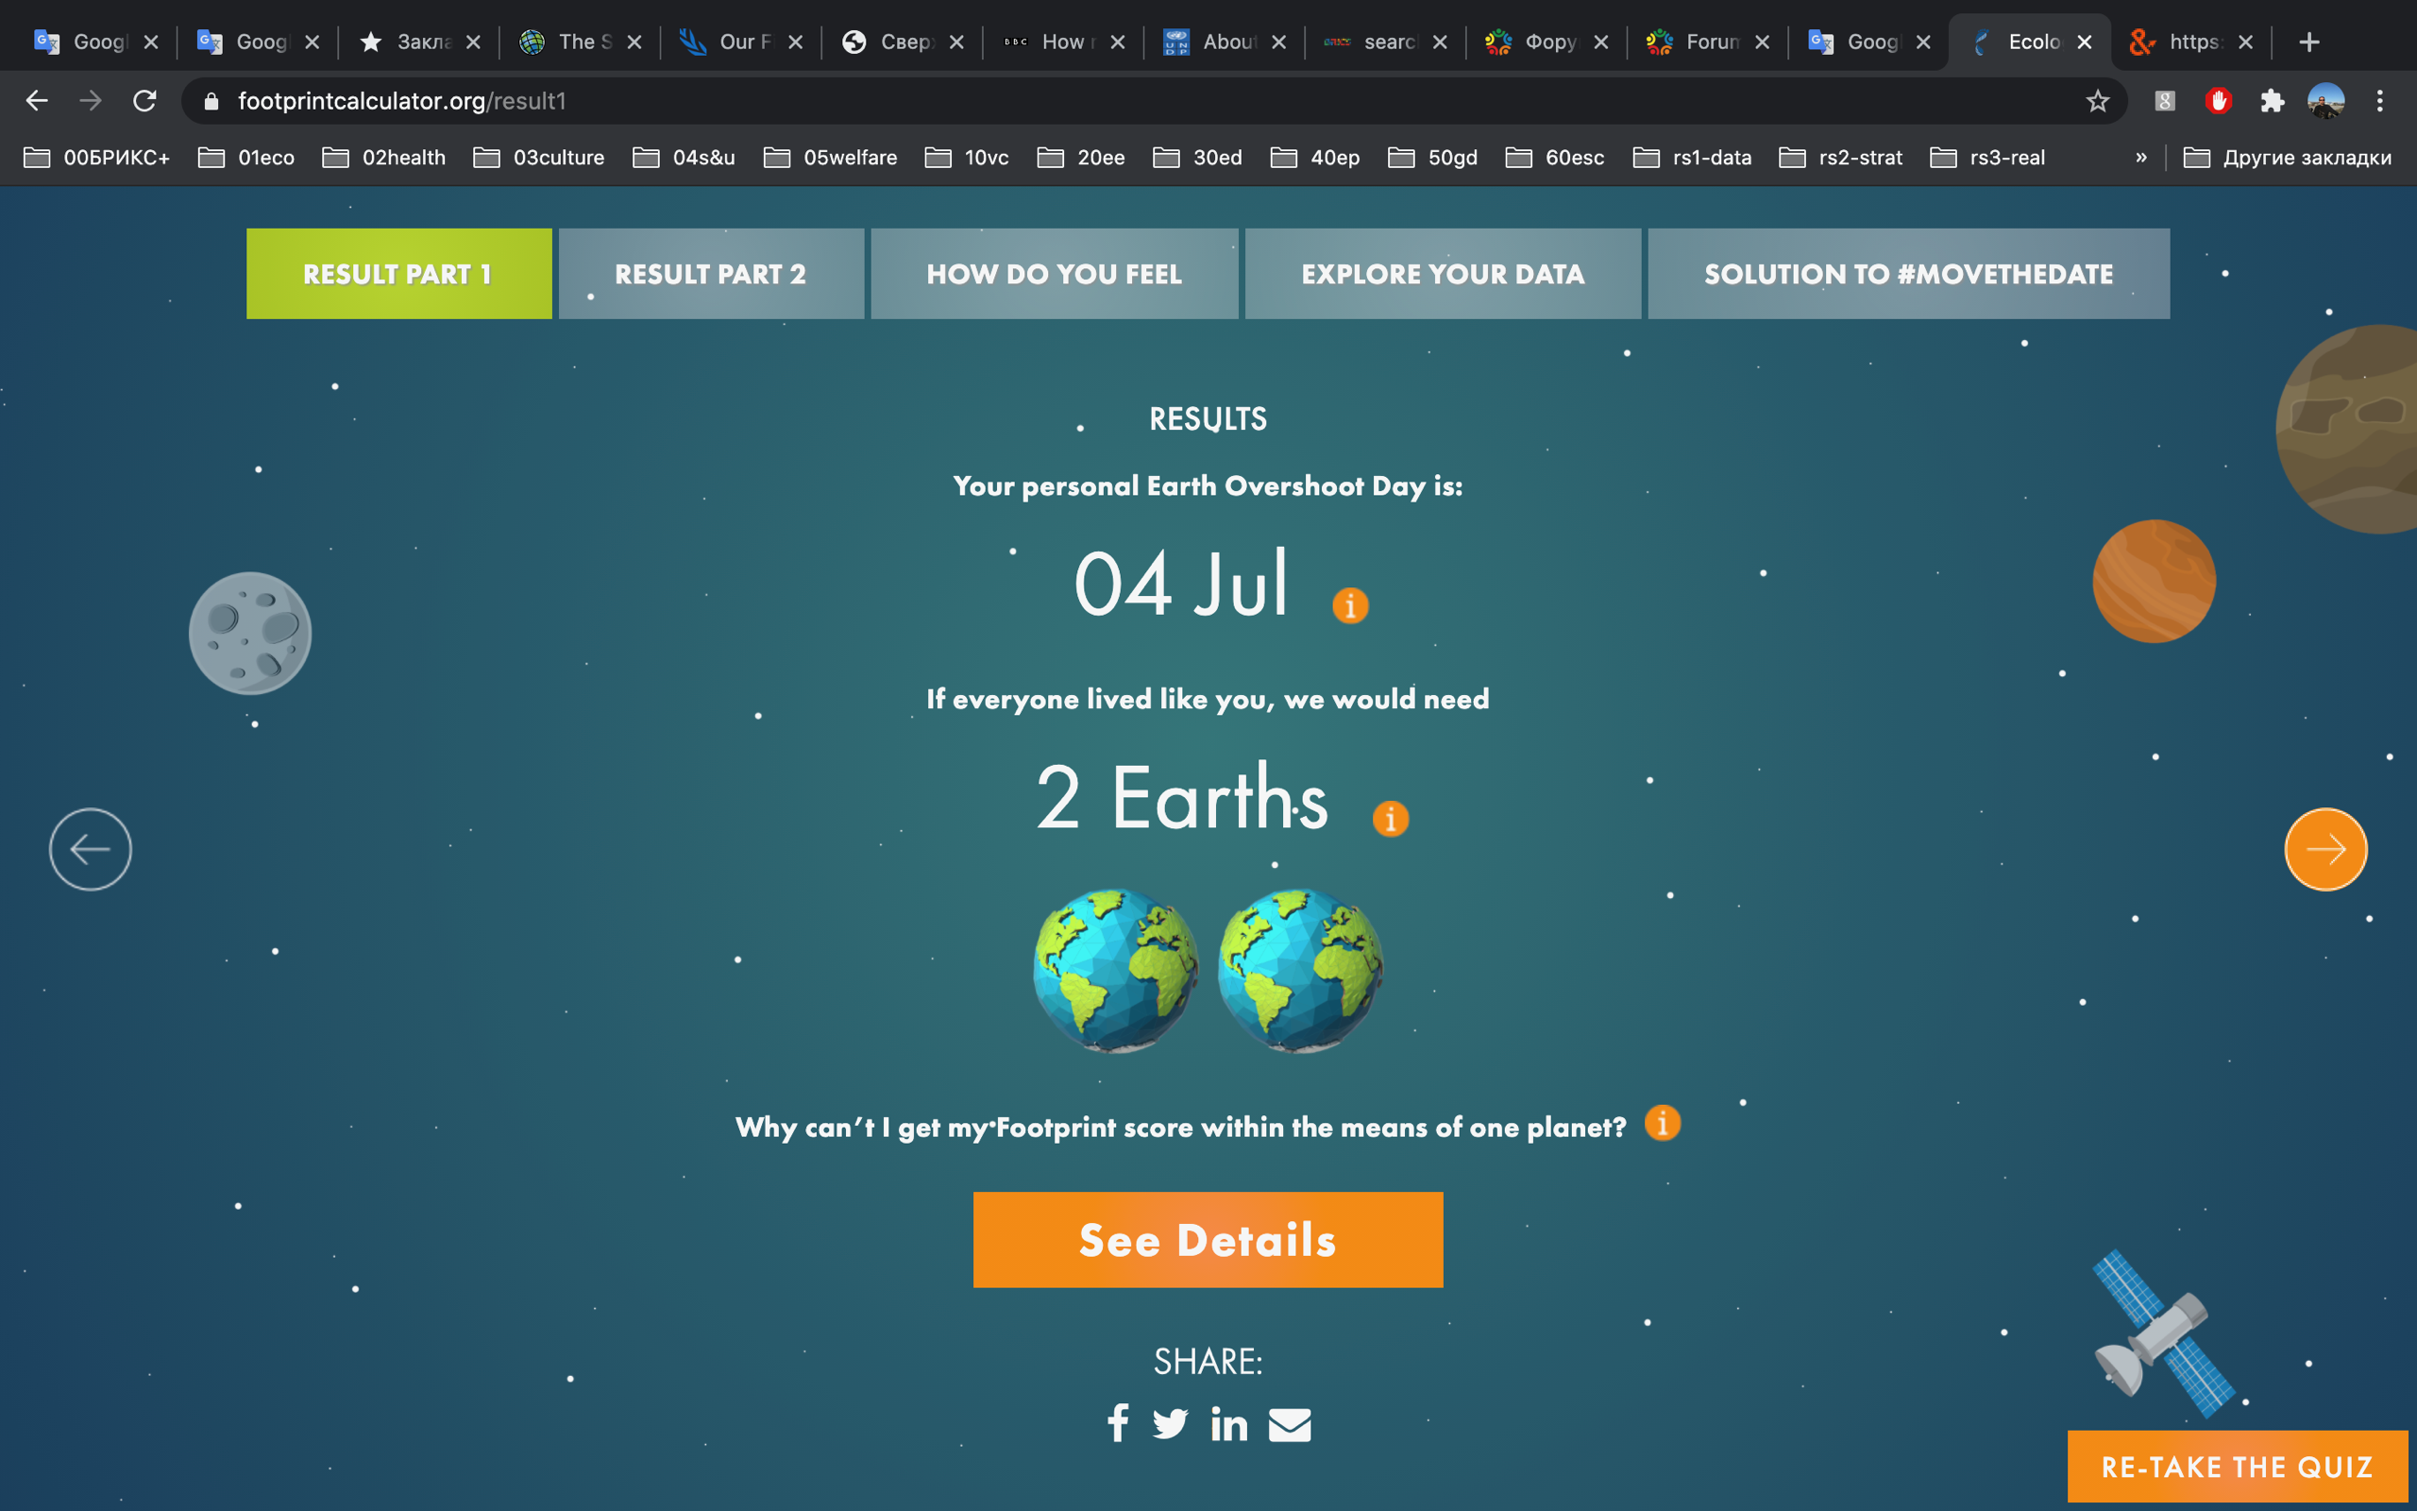
FORUM BRICS+ 22.09.2020 Sochi, Russia
Valery Vakulenko
"The unique potential of the BRICS+ countries in the field of Global ECO-Sustainable Development and its effective implementation ”.
В разы сократили потребление, и все-таки «две Земли»
www.ecosana.club vakulenko@ecoestate.tv;
WhatsApp, tel +79111777716
Assistance Center for saving Nature & Homo Sapiens

Slide 17
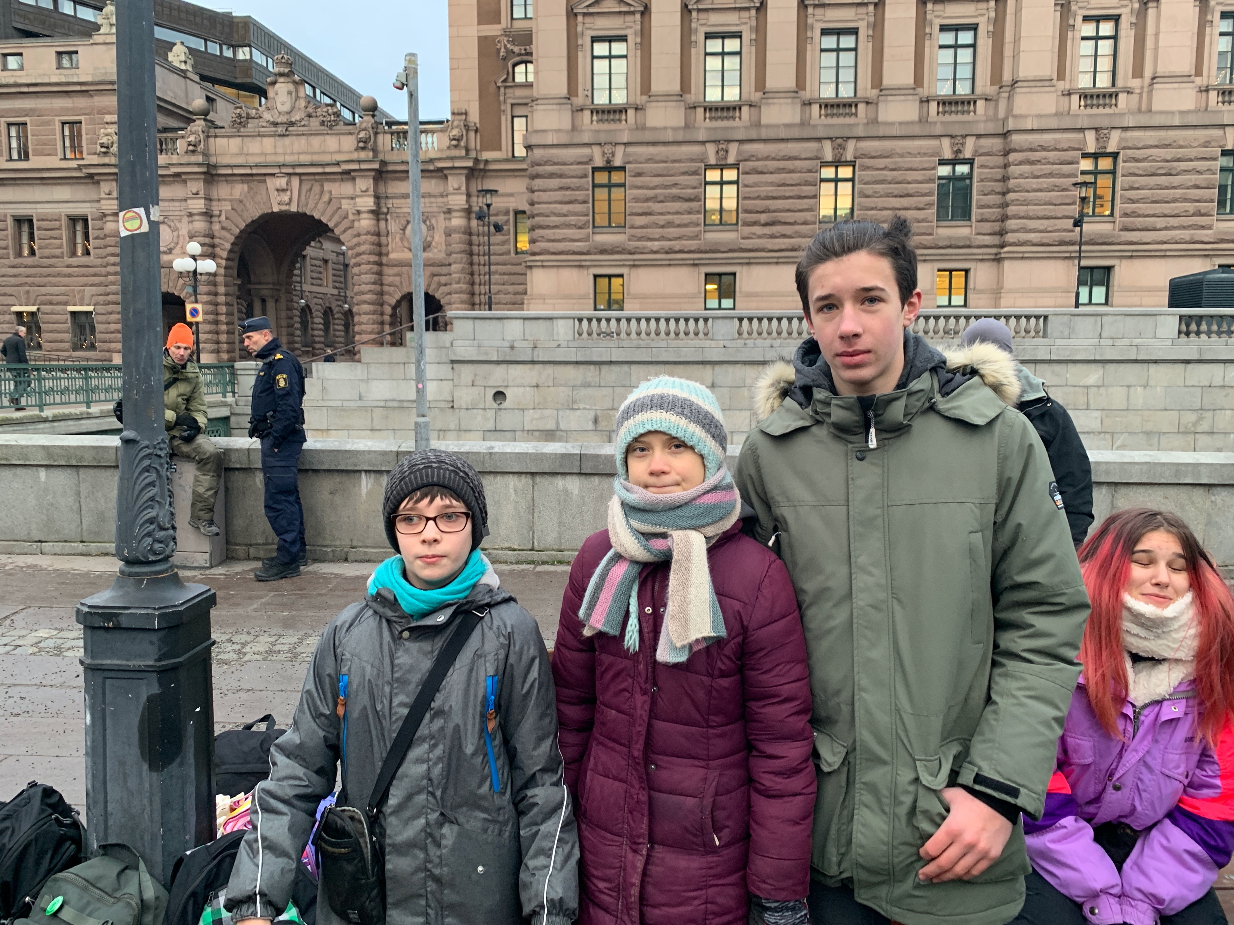
FORUM BRICS+ 22.09.2020 Sochi, Russia
Valery Vakulenko
"The unique potential of the BRICS+ countries in the field of Global ECO-Sustainable Development and its effective implementation ”.
Грета Тунберг делает много полезного. Надо оценивать ее дела а не манеры и внешний вид
www.ecosana.club vakulenko@ecoestate.tv;
WhatsApp, tel +79111777716
Assistance Center for saving Nature & Homo Sapiens

Slide 18
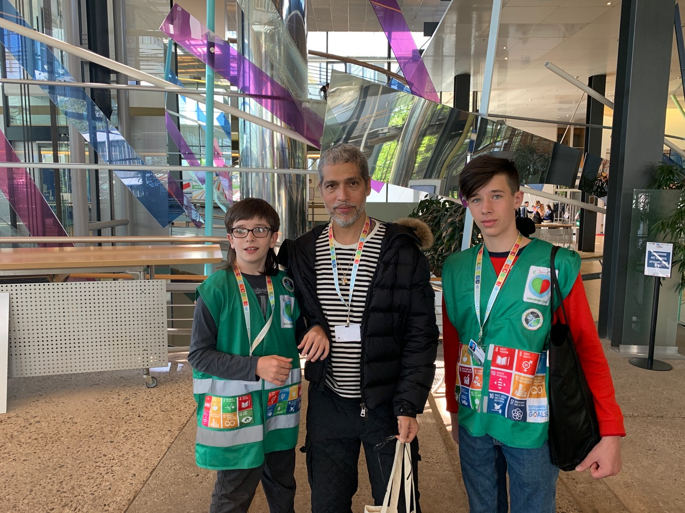
FORUM BRICS+ 22.09.2020 Sochi, Russia
Valery Vakulenko
"The unique potential of the BRICS+ countries in the field of Global ECO-Sustainable Development and its effective implementation ”.
www.ecosana.club vakulenko@ecoestate.tv;
WhatsApp, tel +79111777716
Assistance Center for saving Nature & Homo Sapiens

Slide 19
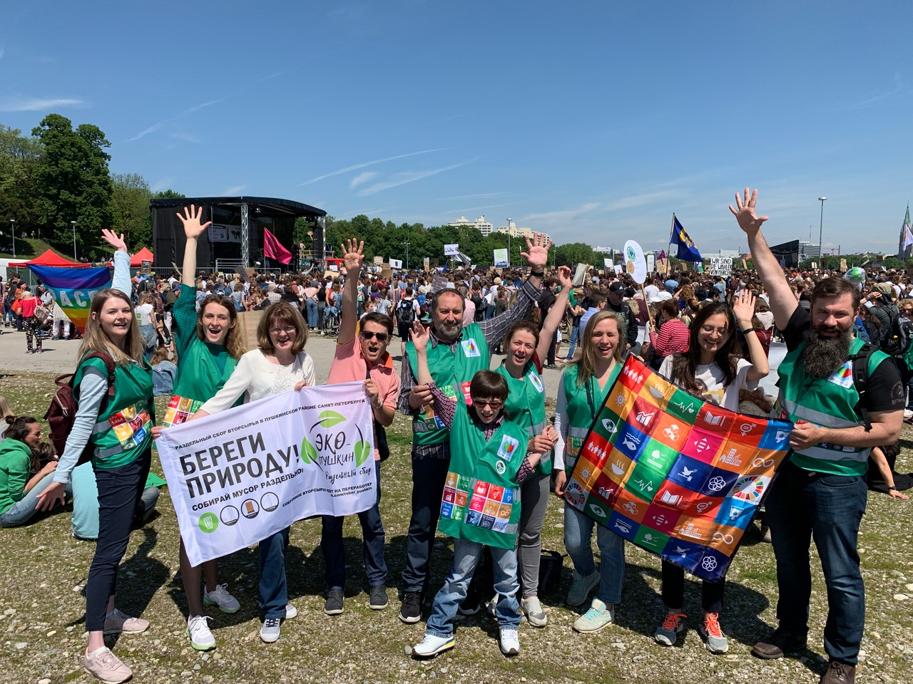
FORUM BRICS+ 22.09.2020 Sochi, Russia
Valery Vakulenko
"The unique potential of the BRICS+ countries in the field of Global ECO-Sustainable Development and its effective implementation ”.
В странах, где зеленых поддерживают или хотя бы не мешают – экология гораздо лучше
www.ecosana.club vakulenko@ecoestate.tv;
WhatsApp, tel +79111777716
Assistance Center for saving Nature & Homo Sapiens

Slide 20
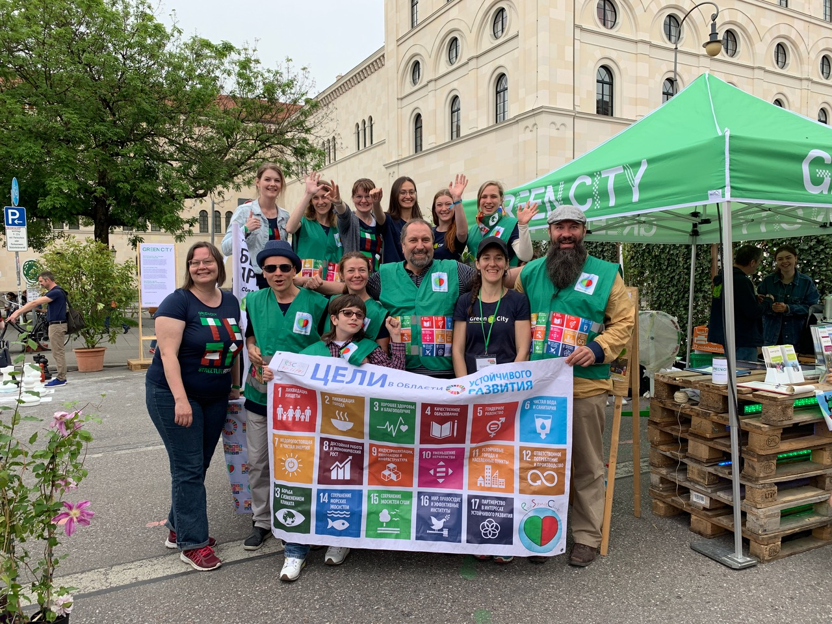
FORUM BRICS+ 22.09.2020 Sochi, Russia
Valery Vakulenko
"The unique potential of the BRICS+ countries in the field of Global ECO-Sustainable Development and its effective implementation ”.
На целый уикэнд центр города отдают зеленым
www.ecosana.club vakulenko@ecoestate.tv;
WhatsApp, tel +79111777716
Assistance Center for saving Nature & Homo Sapiens

Slide 21
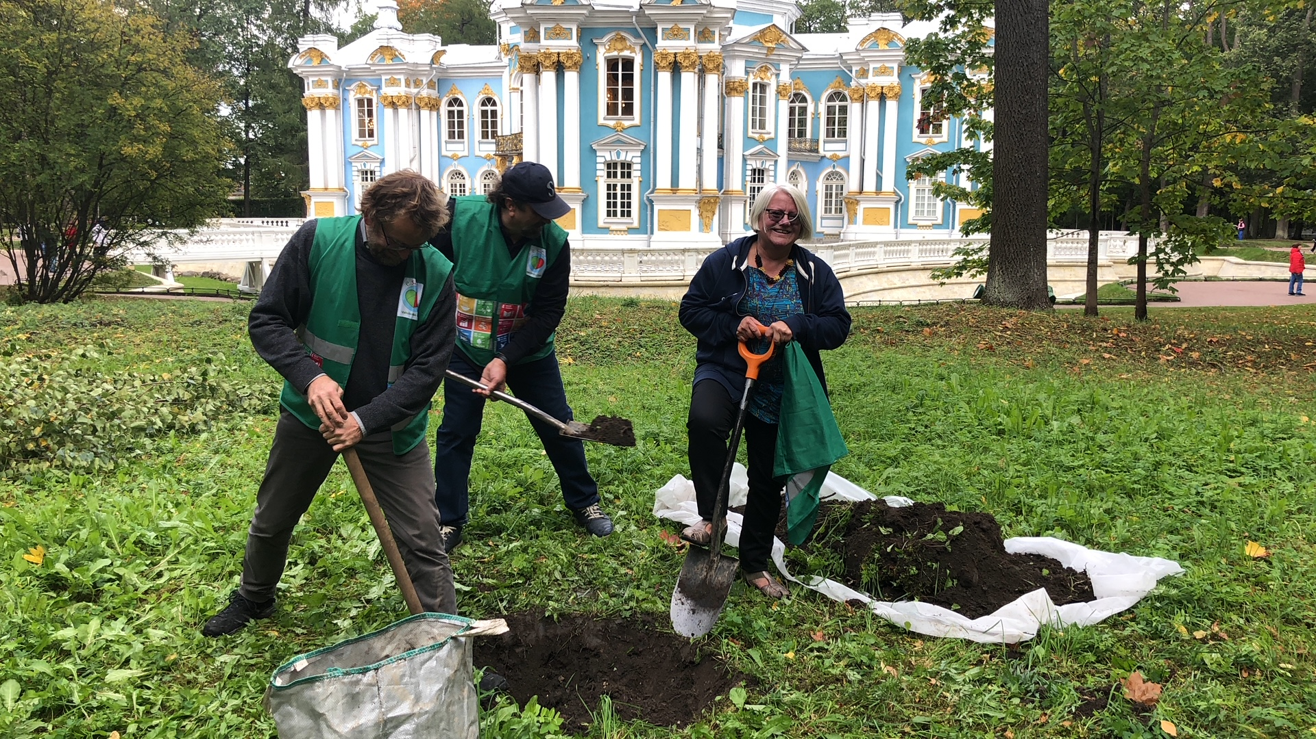
FORUM BRICS+ 22.09.2020 Sochi, Russia
Valery Vakulenko
"The unique potential of the BRICS+ countries in the field of Global ECO-Sustainable Development and its effective implementation ”.
www.ecosana.club vakulenko@ecoestate.tv;
WhatsApp, tel +79111777716
Assistance Center for saving Nature & Homo Sapiens

Slide 22
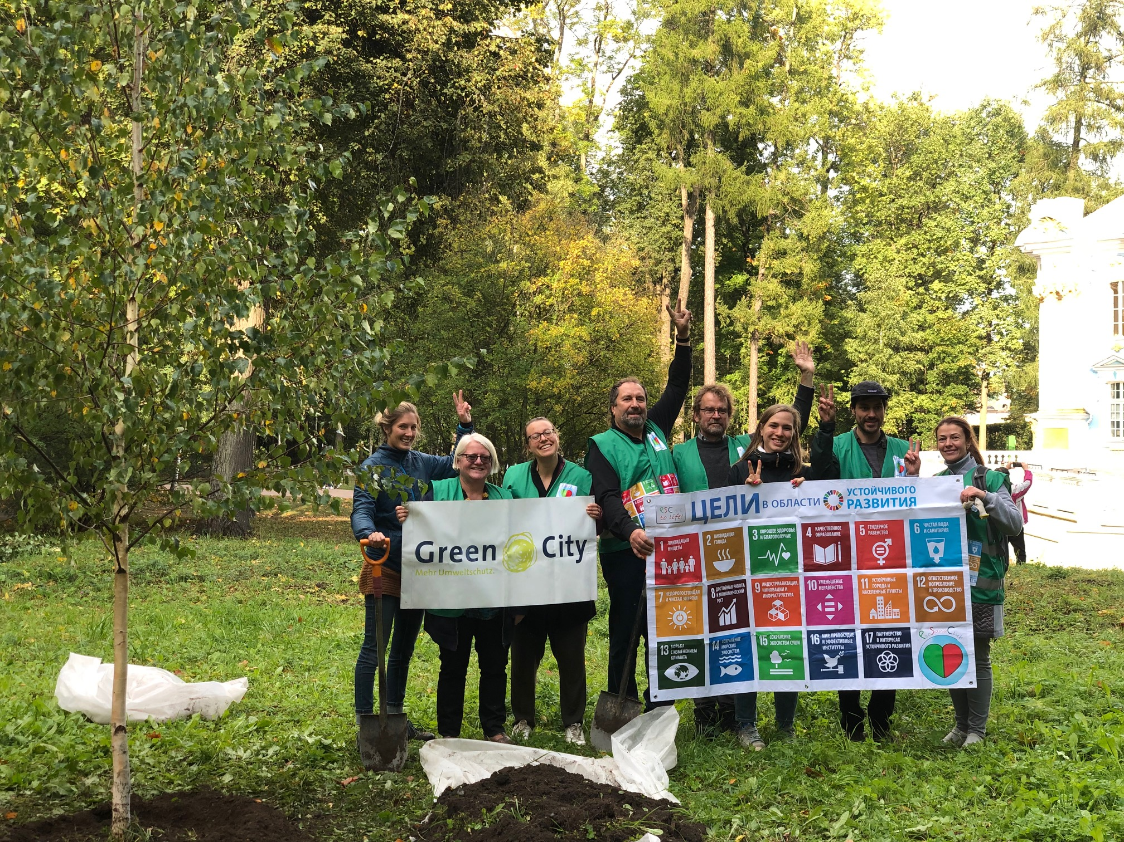
FORUM BRICS+ 22.09.2020 Sochi, Russia
Valery Vakulenko
"The unique potential of the BRICS+ countries in the field of Global ECO-Sustainable Development and its effective implementation ”.
www.ecosana.club vakulenko@ecoestate.tv;
WhatsApp, tel +79111777716
Assistance Center for saving Nature & Homo Sapiens

Slide 23
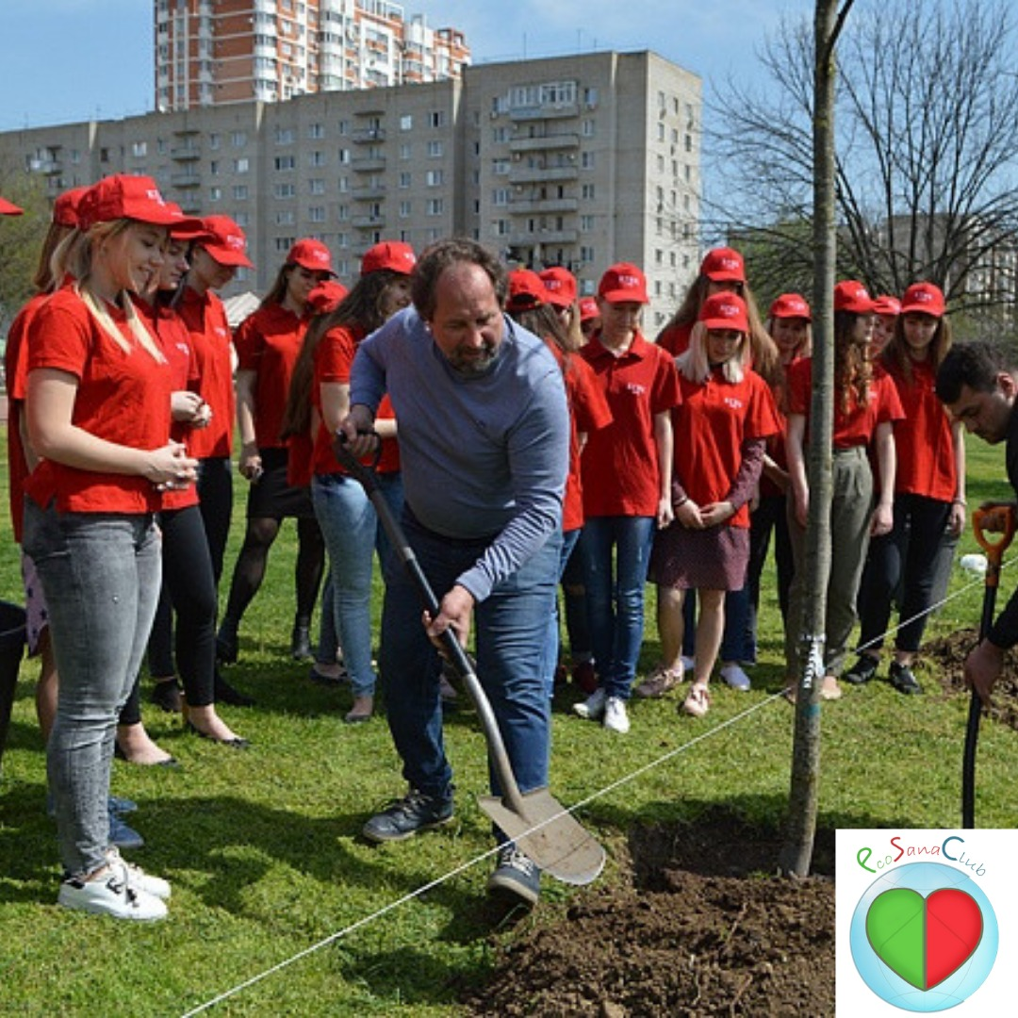
FORUM BRICS+ 22.09.2020 Sochi, Russia
Valery Vakulenko
"The unique potential of the BRICS+ countries in the field of Global ECO-Sustainable Development and its effective implementation ”.
www.ecosana.club vakulenko@ecoestate.tv;
WhatsApp, tel +79111777716
Assistance Center for saving Nature & Homo Sapiens

Slide 24
FORUM BRICS+ 22.09.2020 Sochi, Russia
Valery Vakulenko
"The unique potential of the BRICS+ countries in the field of Global ECO-Sustainable Development and its effective implementation ”.
www.ecosana.club vakulenko@ecoestate.tv;
WhatsApp, tel +79111777716
Assistance Center for saving Nature & Homo Sapiens

Slide 25
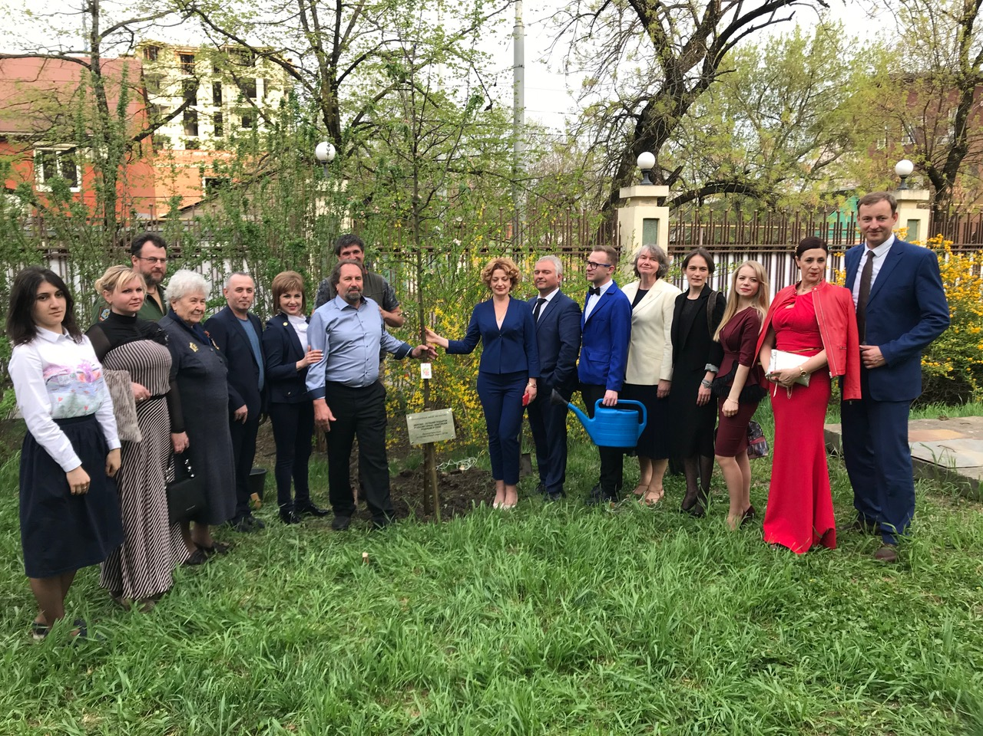
FORUM BRICS+ 22.09.2020 Sochi, Russia
Valery Vakulenko
"The unique potential of the BRICS+ countries in the field of Global ECO-Sustainable Development and its effective implementation ”.
Посадить дерево это не только спасительно, но еще и удовольствие.
Лучший подарок на день рождения
www.ecosana.club vakulenko@ecoestate.tv;
WhatsApp, tel +79111777716
Assistance Center for saving Nature & Homo Sapiens

Slide 26
FORUM BRICS+ 22.09.2020 Sochi, Russia
Valery Vakulenko
"The unique potential of the BRICS+ countries in the field of Global ECO-Sustainable Development and its effective implementation ”.
www.ecosana.club vakulenko@ecoestate.tv;
WhatsApp, tel +79111777716
Assistance Center for saving Nature & Homo Sapiens

Slide 27
FORUM BRICS+ 22.09.2020 Sochi, Russia
Valery Vakulenko
"The unique potential of the BRICS+ countries in the field of Global ECO-Sustainable Development and its effective implementation ”.
www.ecosana.club vakulenko@ecoestate.tv;
WhatsApp, tel +79111777716
Assistance Center for saving Nature & Homo Sapiens

